Slide 1
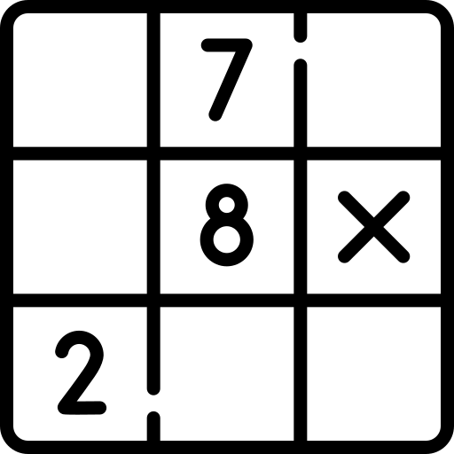
Sudoku solver
project review
by Daniil Khlyvniuk

Slide 2

Links
source code
will be deployment link (if it’s done)

Slide 3

Frontend
UI
User’s input
Display:
Result sudoku image
Users history
Model’s stats

Slide 4

Database api
Save user to db
Save user’s sudokus to db

Slide 5

AI api
Trains model for detection digits
Saves and contains model for detection digits
Processing sudoku images
Resolving sudokus
Creating resolved sudoku image

Slide 6
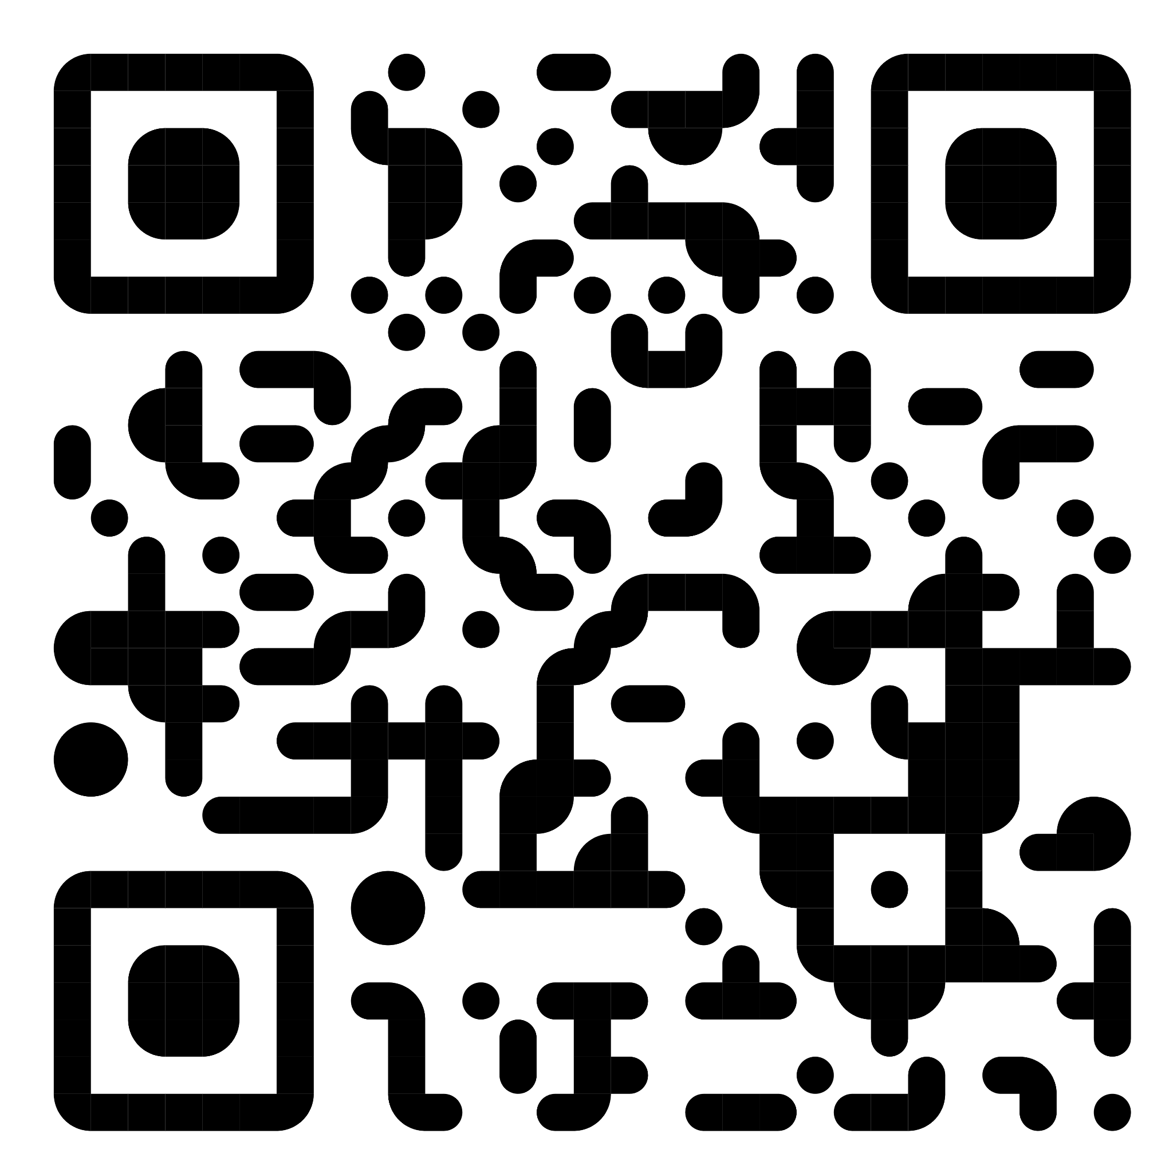
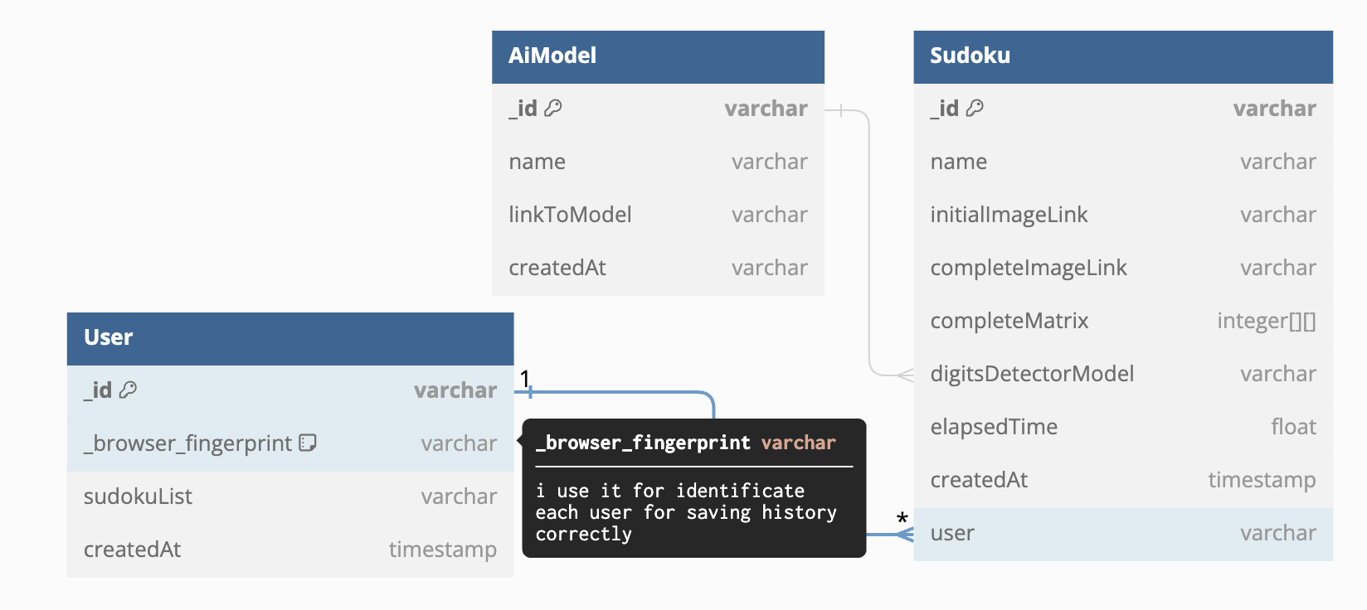

Database
click to see details

Slide 7






















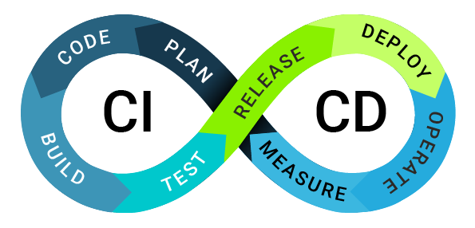





Application architecture and technology stack
Frontend | database-backend | ai-backend | services / tools

Slide 8
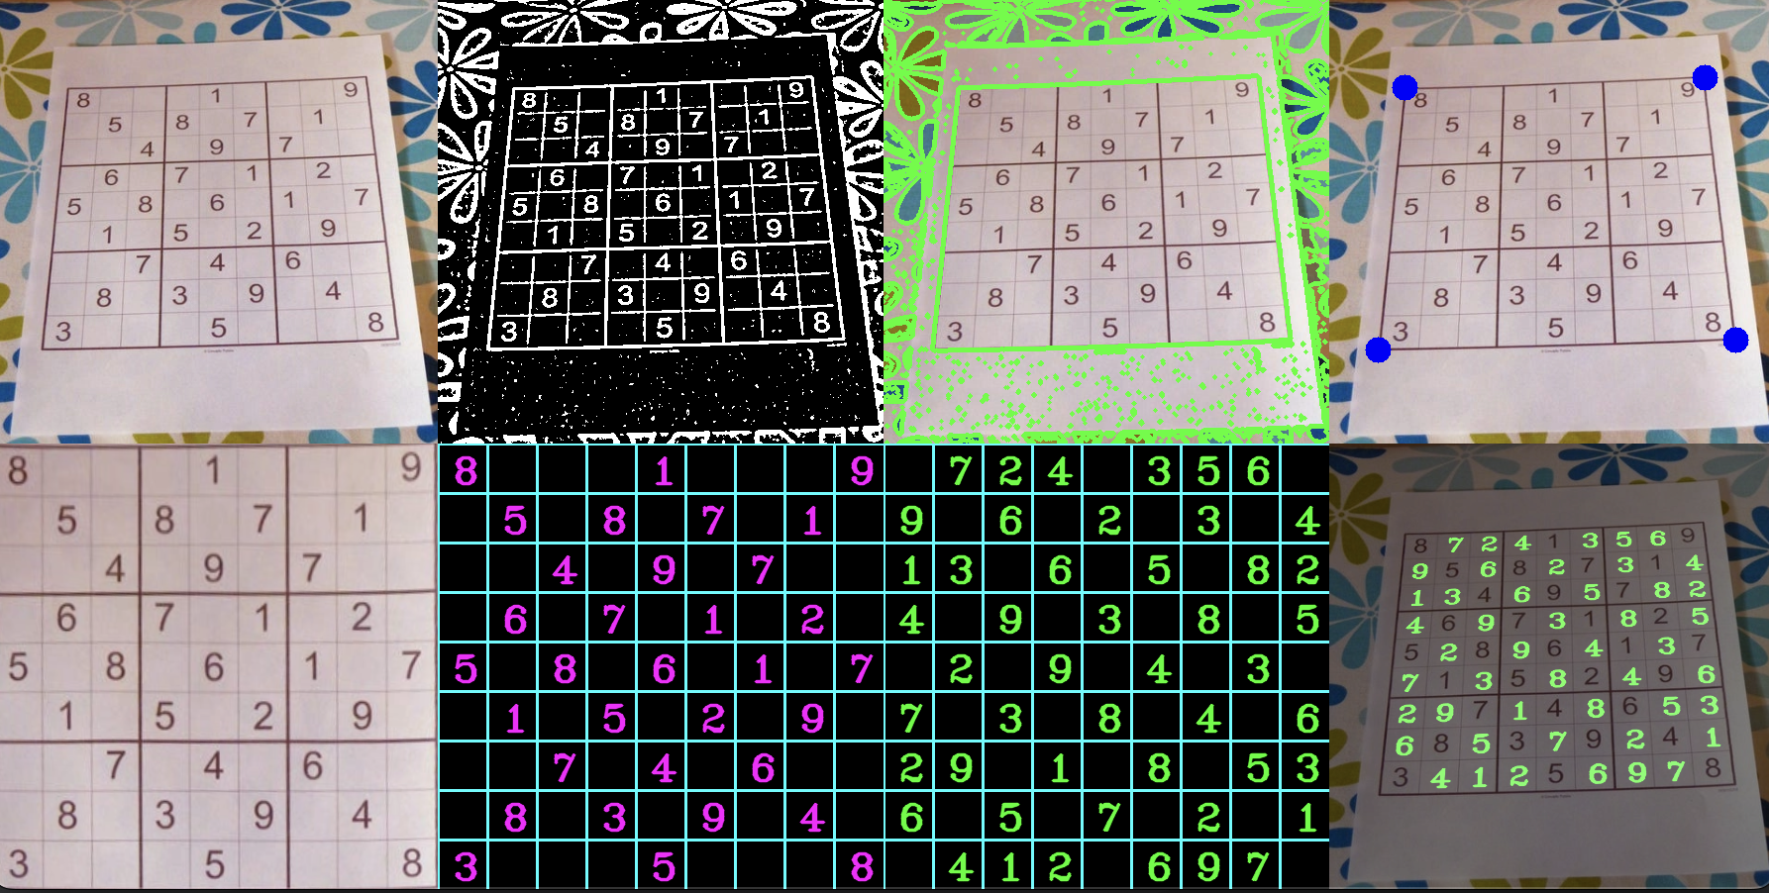
Initial image processing
Will be added som screenshots, maybe short description
Coming soon . . .

Slide 9
Digits detector model
Will be added some charts, screenshots, maybe short description
Coming soon . . .

Slide 10

Questions 🤔
¿¿¿ Any questions ???

Slide 11
Links, tutorials, etc.
Will be added links to articles, videos, authors that helped me for creation that project
Coming soon . . .

Slide 12

Good bye 👋!
Thanks for your attention!

